Slide 1
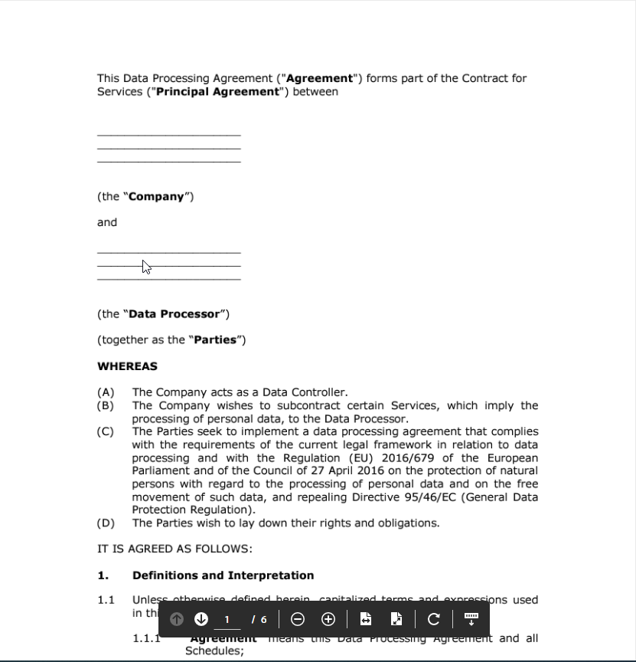
DPA
Import
Company | [Company]
Data Processor | [Data Processor and parties]
[1.1.9] Services | [Services]
[13.1] Agreement laws | [This Agreement is governed by the laws of]
Export
DPIA
OpenBike II
BIO

Slide 2
Use case
Building block
Breach
Agreement
Standards
Authentica-tion method
Certificate
Transport aspects
Aggregation method
Conflict
Terms and conditions
Processing aspects
Geo aggregation
Archive aspects
Time aggregation
Requirement

